Slide 1


Arizona Crustaceans in Extreme Environments:
The Elevated CO2 in Montezuma Well
Northern Arizona University
By: Darienne Nez
Mentor: Dr. Stephen Shuster

Slide 2
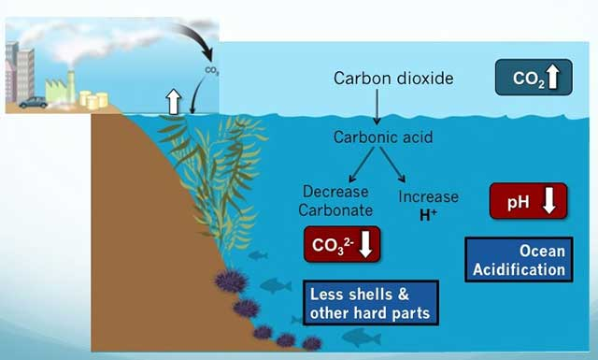
Water Acidification

Slide 3
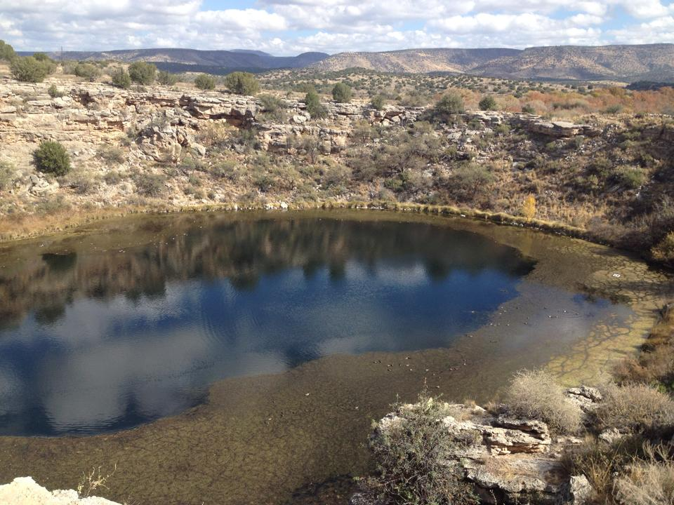
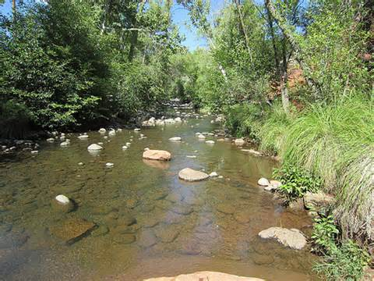
Montezuma Well & Beaver Creek

Slide 4
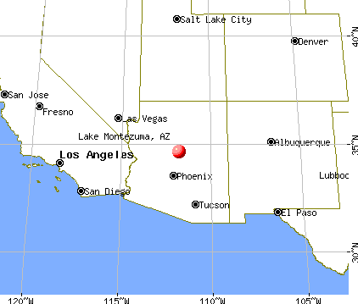
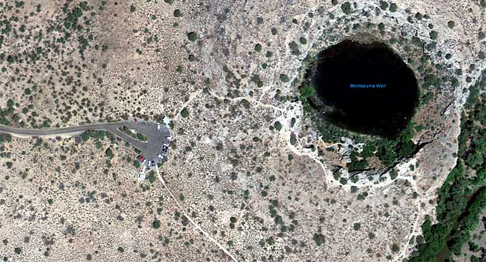
Montezuma Well

Slide 5
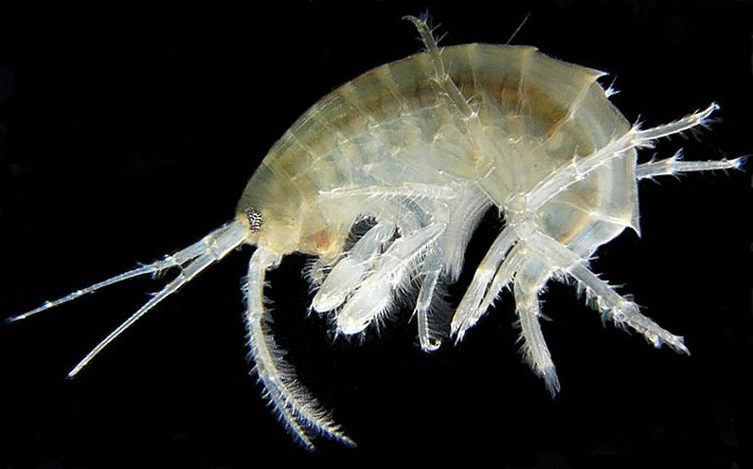
Montezuma Well Amphipod

Slide 6
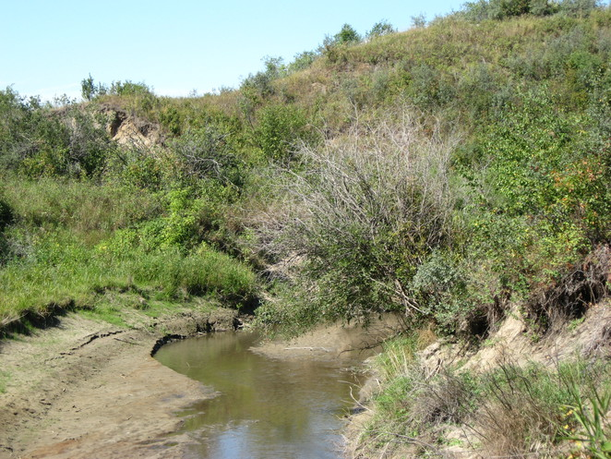
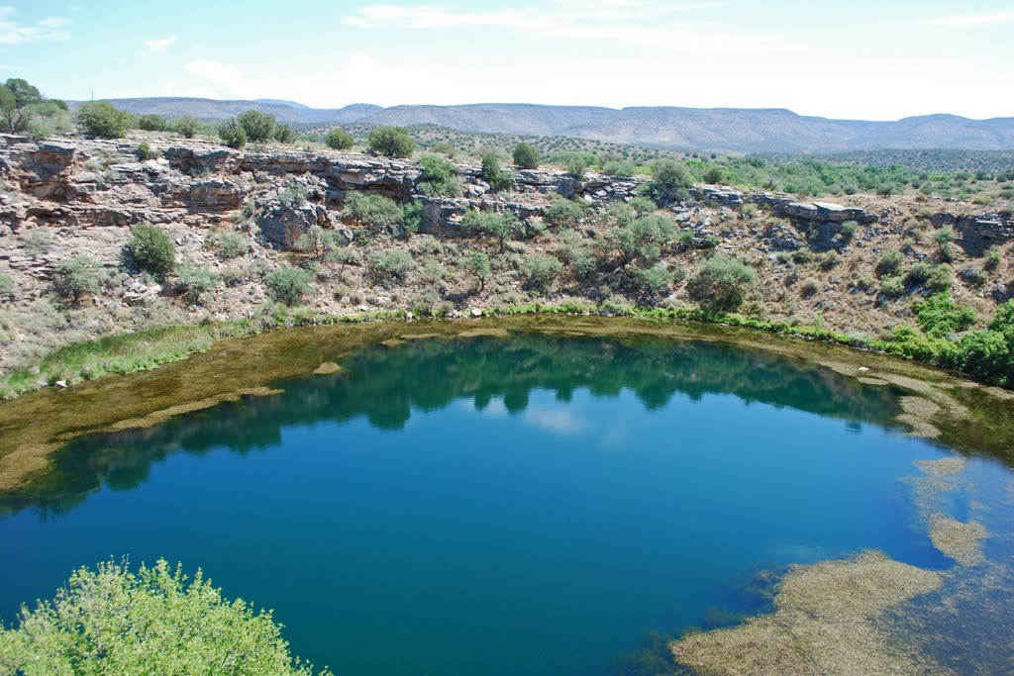
Water Chemistry:
  Beaver Creek and Montezuma Well water chemistry
 | pH | Temperature | Arsenic (As)
Beaver Creek | 7.2 | 57-89 | 10ppb
Montezuma Well | 6.4 | 70 | 100ppb

Slide 7
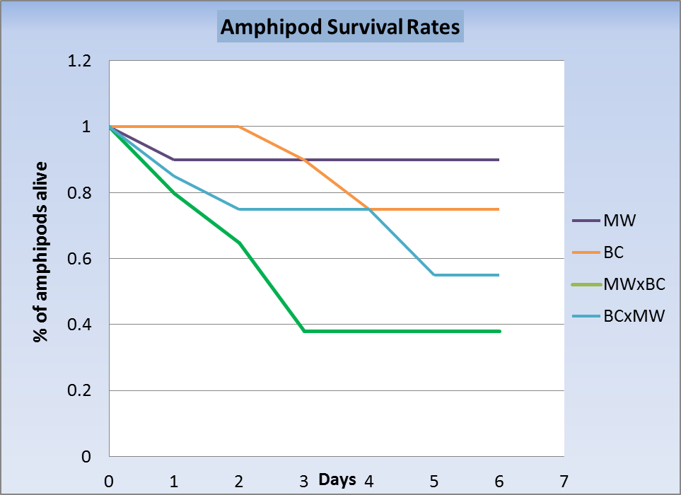
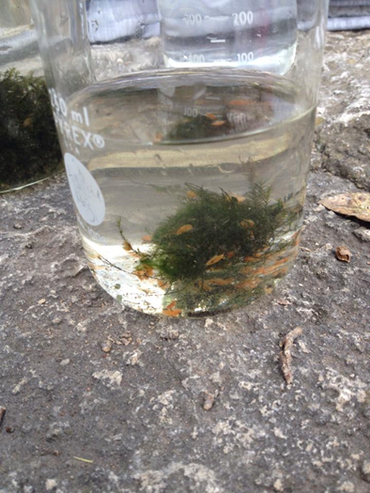
Rate of Survival

Slide 8
Montezuma Well Amphipod Trial
G-test for to compare the expected and observed data
Table 1: shows the amphipods from both Montezuma Well and Beaver Creek and how well the amphipods were able to withstand the different water.
Montezuma Well Amphipod Trial
 | MW | BC | MWA x BC | BCA x MW
Dead | 2 | 5 | 12 | 9 | 28
Live | 18 | 15 | 8 | 11 | 52
Total: | 20 | 20 | 20 | 20 | 80

Slide 9
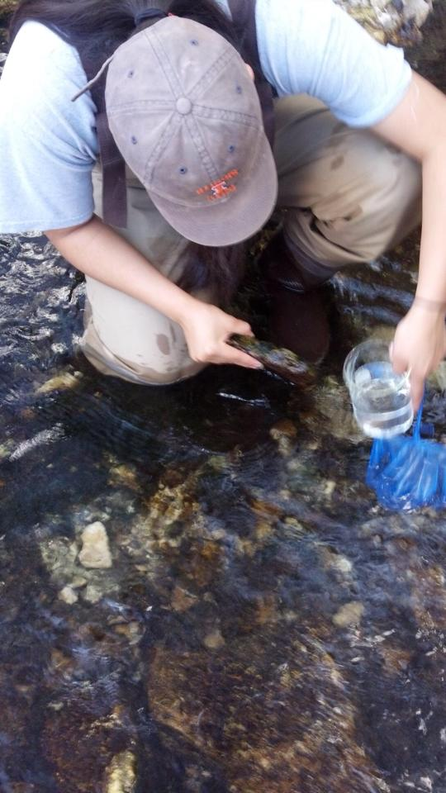
Conclusion:
Amphipods survive well in native water but significantly less well in non-native water, suggesting that amphipods are adapted to their local conditions
Amphipods could possess structural and physiological adaptations that allow them to survive and adapt within Montezuma Well.
G-test results show that the low survival rate of the tested amphipods are not by chance.

Slide 10
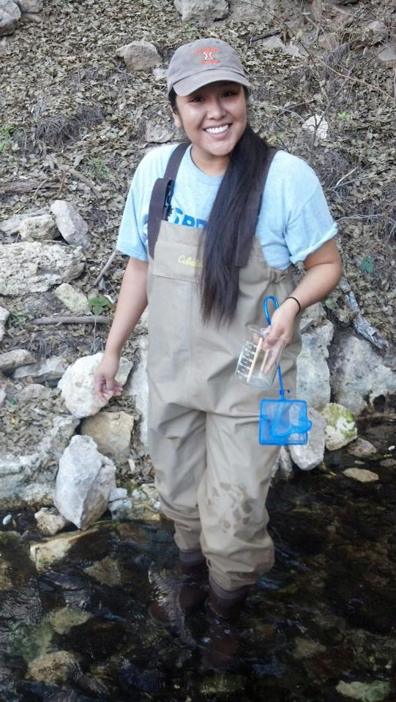
Acknowledgements
NAU NASA Space Grant Program
Dr. Stephen Shuster
Montezuma Well National Park Service

Slide 11
Questions?

